Slide 1
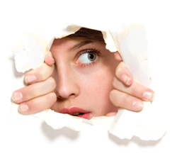
Phobias and Fears

Slide 2
What is Fear
Fear is an emotion. It is generally induced when the subject perceives a threat. Phobia is the Greek word for ‘fear’ and can be defined as the “excessive or unreasonable fear of an object, place or situation.

Slide 3
The difference between fear and phobia
The main difference lies in the intensity and severity of the emotions experienced in fear and phobia.

Slide 4
different types of phobias
There are several types of phobias. The common types of phobias can be divided into ‘simple’ phobias or ‘social’ phobias. Simple phobias mainly include fear of specific types of objects, insects or situations such as the fear of flying. Social phobias includes the types of phobias like marked fear of social or performance situations.

Slide 5

Fear of Food Phobia

Slide 6
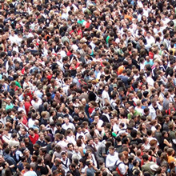
Fear of Crowds Phobia

Slide 7

Fear of Change Phobia

Slide 8
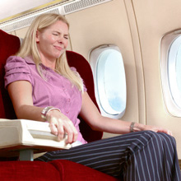
Fear of Flying Phobia

Slide 9

Fear of Needles Phobia

Slide 10

Fear of Driving Phobia

Slide 11

Fear of Success Phobia

Slide 12

Fear of The Lord or God Phobia

Slide 13

Fear of Darkness Phobia

Slide 14
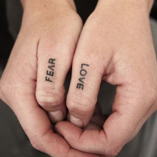
Fear of Love Phobia

Slide 15
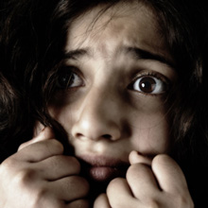
Fear of Fear Phobia

Slide 16

Fear of Bridges Phobia

Slide 17

Fear of Death Phobia

Slide 18

Fear of Public Speaking Phobia

Slide 19
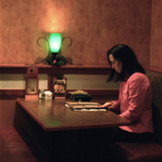
Fear of Being Alone Phobia

Slide 20

Fear of Heights Phobia

Slide 21

Fear of Open or Crowded Spaces Phobia

Slide 22
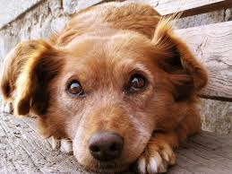
Fear of Dogs Phobia

Slide 23
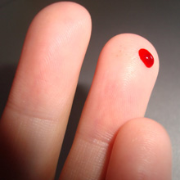
Fear of Blood Phobia

Slide 24
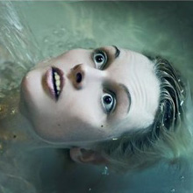
Fear of Water Phobia

Slide 25

Fear of The Number 13 Phobia

Slide 26
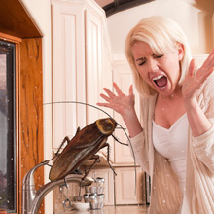
Fear of Bugs and Insects Phobia

Slide 27
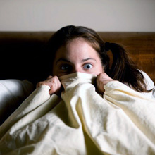
Fear of Sleep Phobia

Slide 28
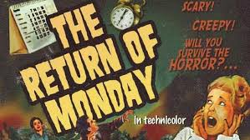
Fear of Monday Phobia

Slide 29
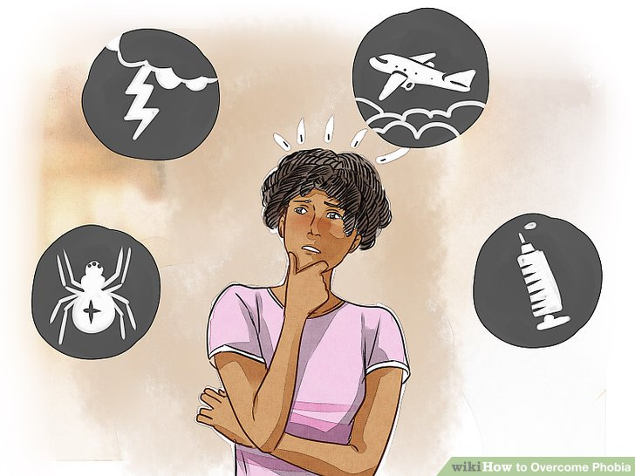
A phobia is an excessive and irrational fear reaction.

Slide 30

Genetic and environmental factors.
Distressing events.
Exposure to confined spaces.
Ongoing medical conditions.
Substance Abuse.
Depression.

Slide 31
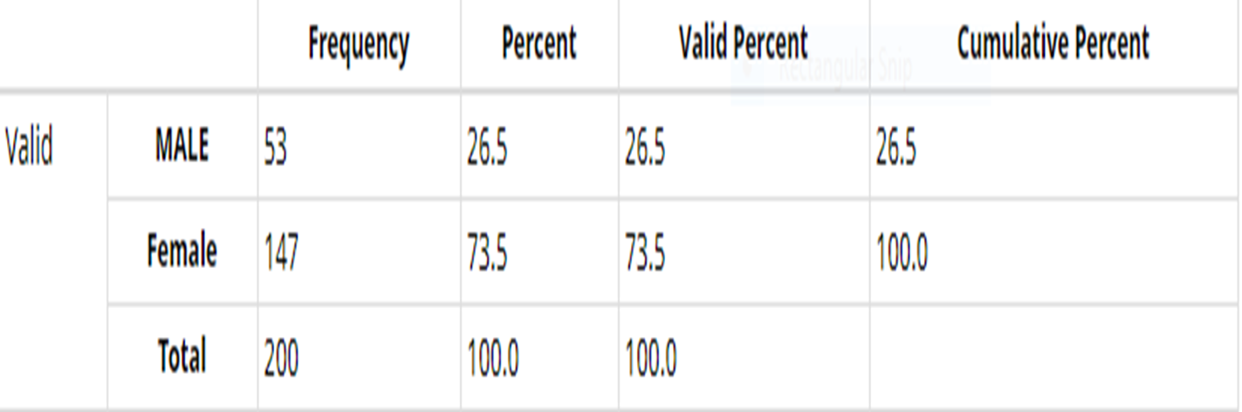

Slide 32
Social Anxiety Disorder, Social Phobia

Slide 33
Social Anxiety Disorder, Social Phobia
Many people get nervous or self-conscious on occasion, like when giving a speech or interviewing for a new job. But social anxiety, or social phobia, is more than just shyness or occasional nerves. With social anxiety disorder, your fear of embarrassing yourself is so intense that you avoid situations that can trigger it

Slide 34
Social Anxiety Disorder, Social Phobia
social anxiety disorder or social phobia is the fear of being scrutinized, judged, or embarrassed in public. You may be afraid that people will think badly of you or that you won’t measure up in comparison to others. And even though you probably realize that your fears of being judged are at least somewhat irrational and overblown

Slide 35
Common social phobia triggers
Meeting new people
Being the center of attention
Being watched while doing something
Making small talk
Public speaking
Performing on stage
Being teased or criticized

Slide 36
Common social phobia triggers
Talking with “important” people or authority figures
Being called on in class
Making phone calls
Taking exams
Eating or drinking in public
Speaking up in a meeting/precentations
Attending parties or other social gatherings

Slide 37
Signs and symptoms of social phobia
Just because you occasionally get nervous in social situations doesn’t mean you have social anxiety disorder or social phobia. Many people are shy or self-conscious—at least from time to time—yet it doesn’t get in the way of their everyday functioning. Social anxiety disorder, on the other hand, does interfere with your normal routine and causes tremendous distress.

Slide 38
Emotional symptoms social phobia
Excessive self-consciousness and anxiety in everyday social situations
Intense worry for days, weeks, or even months before an upcoming social situation
Extreme fear of being watched or judged by others, especially people you don’t know
Fear that you’ll act in ways that that will embarrass or humiliate yourself
Fear that others will notice that you’re nervous

Slide 39
Physical symptoms of social phobia
Red face, or blushing
Shortness of breath
Upset stomach, nausea (i.e. butterflies)
Trembling or shaking (including shaky voice)
Racing heart or tightness in chest
Sweating or hot flashes
Feeling dizzy or faint

Slide 40
Behavioral symptoms of social phobia
Avoiding social situations to a degree that limits your activities or disrupts your life
Staying quiet or hiding in the background in order to escape notice and embarrassment
A need to always bring a buddy along with you wherever you go
Drinking before social situations in order to soothe your nerves

Slide 41
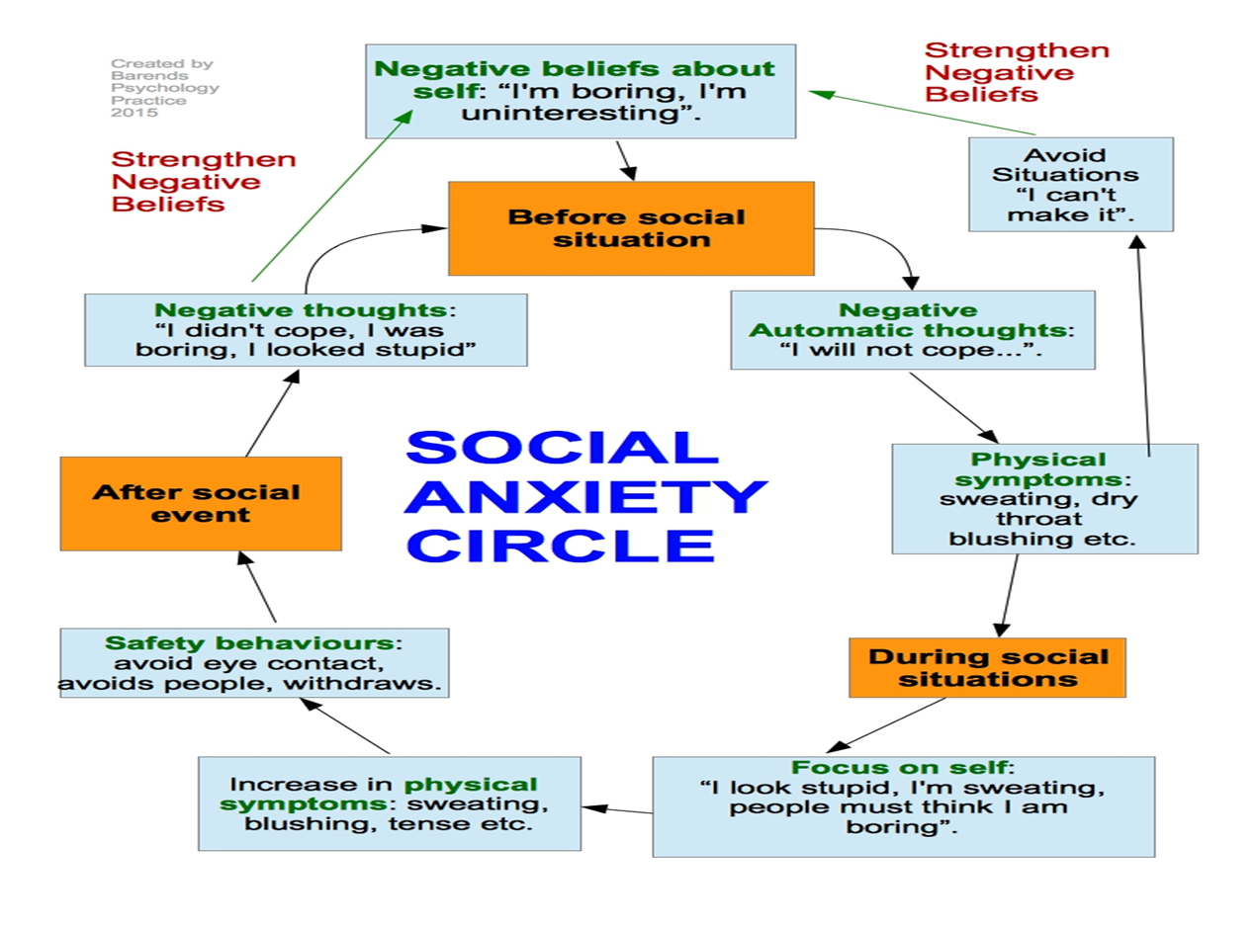
Social phobia circle

Slide 42
Social anxiety/phobia disorder treatment
The best treatment approach for social anxiety disorder varies from person to person. You may find that self-help strategies are enough to ease your social anxiety symptoms. But if you’ve tried the techniques below and you’re still struggling with disabling anxiety, you may need professional help as well.

Slide 43
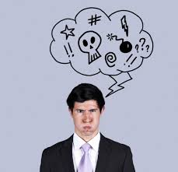
negative thoughts

Slide 44
1: Challenge negative thoughts
The first step is to identify the automatic negative thoughts that underlie your fear of social situations. For example, if you‘re worried about an upcoming work presentation, the underlying negative thought might be: “I’m going to blow it. Everyone will think I’m completely incompetent.”

Slide 45
1: Challenge negative thoughts
The next step is to analyze and challenge them. It helps to ask yourself questions about the negative thoughts: “Do I know for sure that I’m going to blow the presentation?” or “Even if I’m nervous, will people necessarily think I’m incompetent?” Through this logical evaluation of your negative thoughts, you can gradually replace them with more realistic and positive ways of looking at social situations that trigger your anxiety.

Slide 46
negative thoughts
Mind reading – Assuming you know what other people are thinking, and that they see you in the same negative way that you see yourself.
Fortune telling – Predicting the future, usually while assuming the worst will happen. You just “know” that things will go horribly, so you’re already anxious before you’re even in the situation.
Catastrophizing – Blowing things out of proportion. If people notice that you’re nervous, it will be “awful,” “terrible,” or “disastrous.”
Personalizing – Assuming that people are focusing on you in a negative way or that what’s going on with other people has to do with you.

Slide 47
2: Learn to control your breath
Learning to slow your breathing down can help you bring your physical symptoms of anxiety back under control. Practicing the following breathing exercise will help you stay calm when you’re the center of attention.
Sit comfortably with your back straight and your shoulders relaxed. Put one hand on your chest and the other on your stomach.

Slide 48
2: Learn to control your breath
Inhale slowly and deeply through your nose for four seconds. The hand on your stomach should rise, while the hand on your chest should move very little.
Hold the breath for two seconds.
Exhale slowly through your mouth for six seconds, pushing out as much air as you can. The hand on your stomach should move in as you exhale, but your other hand should move very little.
Continue to breathe in through your nose and out through your mouth. Focus on keeping a slow and steady breathing pattern of 4-in, 2-hold, and 6-out.

Slide 49
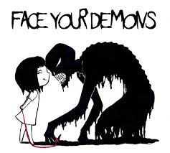
Face your fears

Slide 50
3: Face your fears
Face the social situations you fear rather than avoid them. Avoidance keeps social anxiety disorder going.
Avoidance leads to more problems
Avoidance may also prevent you from doing things you’d like to do or reaching certain goals. For example, a fear of speaking up may prevent you from sharing your ideas at work, standing out in the classroom, or making new friends.

Slide 51
3: Face your fears
Challenging social anxiety one step at a time
The key is to start with a situation that you can handle and gradually work your way up to more challenging situations, building your confidence and coping skills as you move up the “anxiety ladder.”

Slide 52

Build better relationships

Slide 53
4: Build better relationships
Take a social skills class or an assertiveness training class. These classes are often offered at local adult education centers or community colleges.
Volunteer doing something you enjoy, such as walking dogs in a shelter, or stuffing envelopes for a campaign—anything that will give you an activity to focus on while you are also engaging with a small number of like-minded people.
Work on your communication skills. Good relationships depend on clear, emotionally-intelligent communication. If you find that you have trouble connecting to others, learning the basic skills of emotional intelligence can help.

Slide 54

Change your lifestyle

Slide 55
5: Change your lifestyle
Avoid or limit caffeine. Coffee, tea, caffeinated soda, energy drinks, and chocolate act as stimulants that increase anxiety symptoms.
Drink only in moderation. You may be tempted to drink before a party or other social situation in order to calm your nerves, but alcohol increases your risk of having an anxiety attack.
Quit smoking. Nicotine is a powerful stimulant. Smoking leads to higher, not lower, levels of anxiety.
Get adequate sleep. When you’re sleep deprived, you’re more vulnerable to anxiety. Being well rested will help you stay calm in social situations.

